Slide 1
Recent Advances in the PAOFLOW Method—Electronic, Transport and Optical Properties of Real Materials from Projections on Atomic Orbital Bases Marco Buongiorno Nardelli University of North Texas and Santa Fe Institute

Slide 2
Localized orbitals

Slide 3
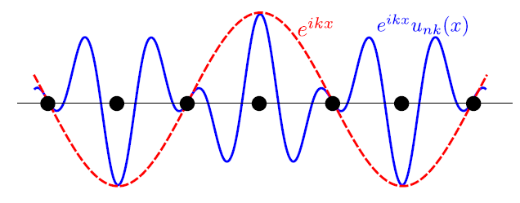
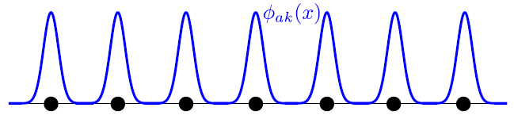
Localized basis sets
Chemical interpretation of the wavefunction
Simple connection with plane-waves via Fourier transforms:
Construction of model Hamiltonians (e.g. strongly correlated systems)
Band structure interpolation
Transport properties
Many more…
Bloch states (plane waves)
Localized states (i.e. atomic orbitals)

Slide 4
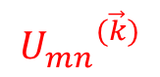
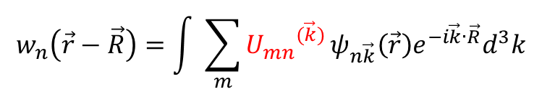
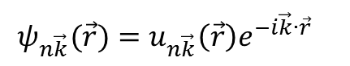
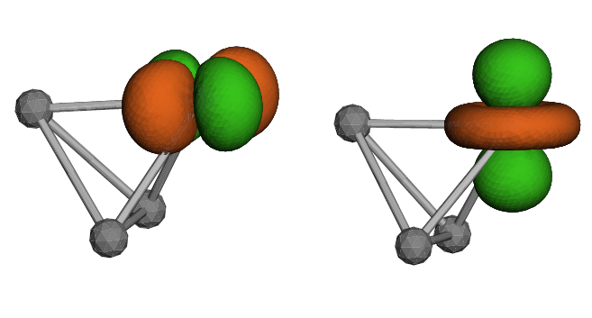
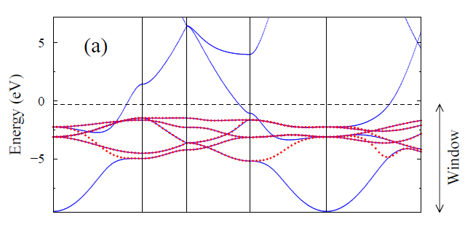
Wannier functions
A convenient localized basis set.
Maximal localization: Unique basis set
Not straightforward (what projectors and how many?)
Internal iterative procedure for disentangling bands (e.g in metals)
Energy window?
Intractable for large number of bands
Bloch
Wannier
N. Marzari et. al. Rev. Mod. Phys. 84, 1419 (2012)

Slide 5
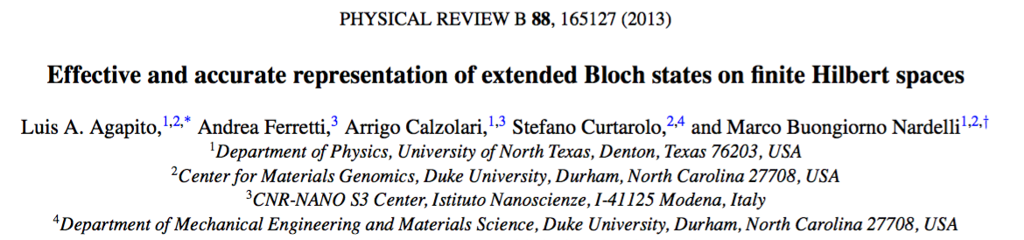
Localized basis sets
Chemical interpretation of the wavefunction
Simple connection with plane-waves via Fourier transforms:
Construction of model Hamiltonians (e.g. strongly correlated systems)
Band structure interpolation
Transport properties
Many more…
Bloch states (plane waves)
Localized states (i.e. atomic orbitals)

Slide 6
The PAOFLOW method

Slide 7
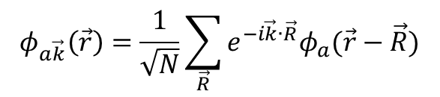
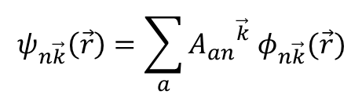
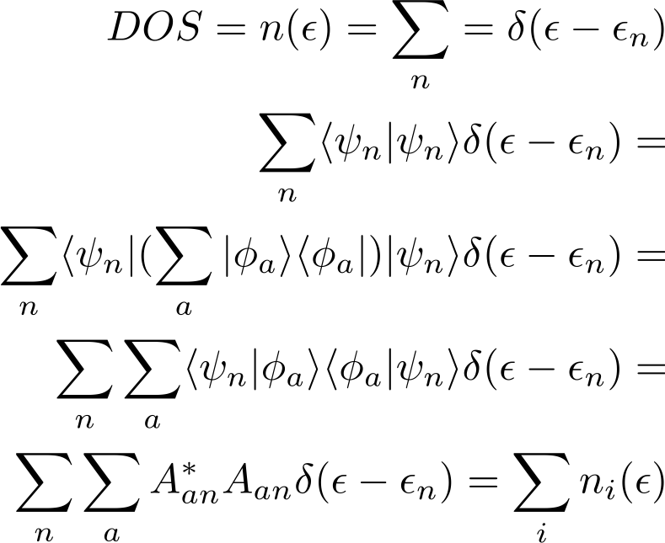
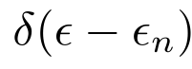
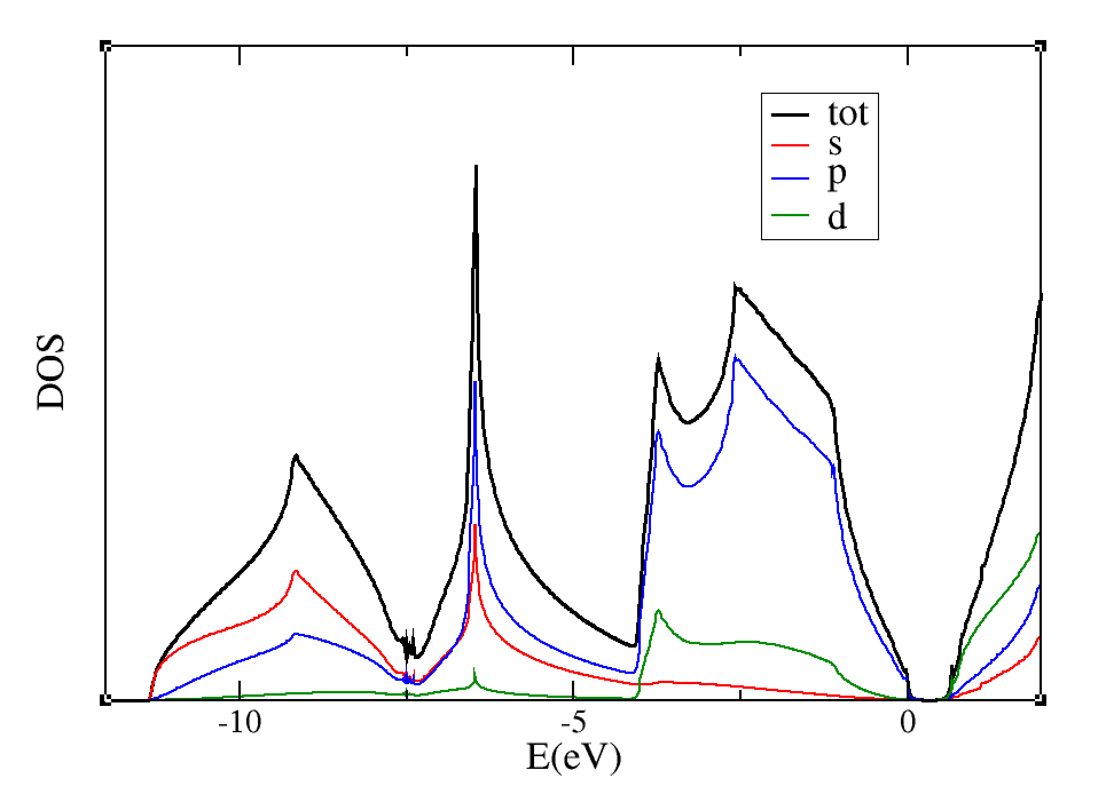
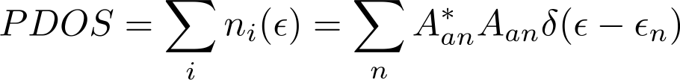
Pseudo-atomic orbitals (PAO)
Readily available from pseudo-potentials:
Connection to Bloch states (i.e Kohn-Sham states from DFT) via a simple projection -- typically done to obtain Projected Density of States (PDOS):
Silicon
a
a
We assume the basis is orthonormal

Slide 8
Density matrix
Lowdin Charges:
Atom # 1: total charge = 3.9897, s = 0.9061,
Atom # 1: total charge = 3.9897, p = 2.3837, pz= 0.7946, px= 0.7946, py= 0.7946,
Atom # 1: total charge = 3.9897, d = 0.6981, dz2= 0.0861, dxz= 0.1753, dyz= 0.1753, dx2-y2= 0.0861, dxy= 0.1753,
Atom # 1: total charge = 3.9897, f = 0.0018, fz3= 0.0003, fxz2= 0.0002, fyz2= 0.0002, fzx2-zy2= 0.0002, fxyz= 0.0003, fx3-3xy2= 0.0003, f3yx2-y3= 0.0003,
Atom # 2: total charge = 3.9897, s = 0.9061,
Atom # 2: total charge = 3.9897, p = 2.3837, pz= 0.7946, px= 0.7946, py= 0.7946,
Atom # 2: total charge = 3.9897, d = 0.6981, dz2= 0.0861, dxz= 0.1753, dyz= 0.1753, dx2-y2= 0.0861, dxy= 0.1753,
Atom # 2: total charge = 3.9897, f = 0.0018, fz3= 0.0003, fxz2= 0.0002, fyz2= 0.0002, fzx2-zy2= 0.0002, fxyz= 0.0003, fx3-3xy2= 0.0003, f3yx2-y3= 0.0003,
Spilling Parameter: 0.0026

Slide 9
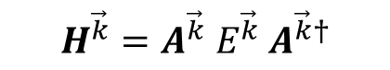
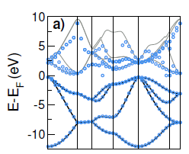
Pseudo-atomic orbitals (PAO)
Readily available from pseudo-potentials:
Connection to Bloch states (i.e Kohn-Sham states from DFT) via a simple projection -- typically done to obtain Projected Density of States (PDOS):
LCAO
Hamiltonian
KS eigenvalues
Si (2s²2p² basis set): 8 atomic orbitals
Valence bands reproduced to high accuracy
Conduction bands deviate strongly from KS eigenvalues.
L. A. Agapito et. al. Phys. Rev. B 88, 165127 (2013)

Slide 10
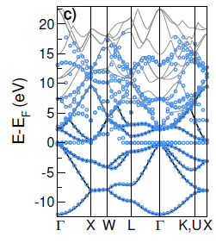
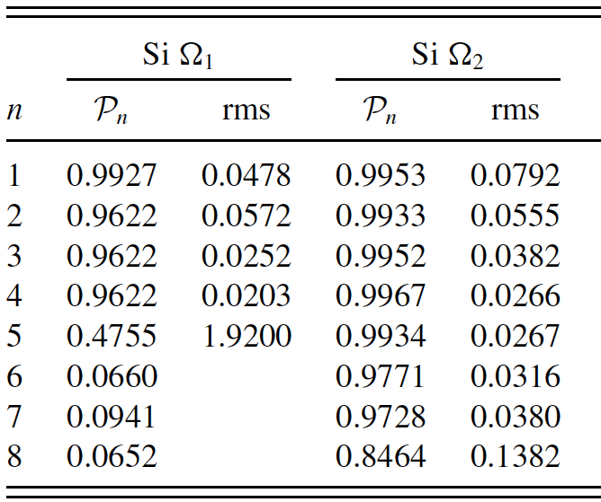
Projectability of bands
LCAO band structure with spd basis set.
Some low energy conduction bands improve.
A set of null eigenvalues are inserted
Projectability:
High projectability bands (i.e. P_{n} ≈ 1) yield accurate LCAO band structure.
Low projectability bands (i.e. P_{n} << 1) yield poor LCAO bands and lead to null eigenstates.

Slide 11
Accurate PAO Hamiltonians
plane
waves
bands
atomic
orbitals
GOOD
projectability
BAD
projectability
11

Slide 12
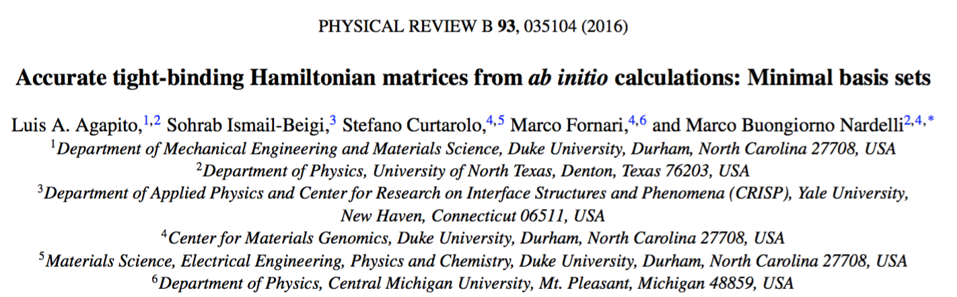
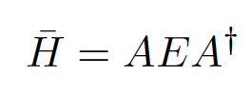
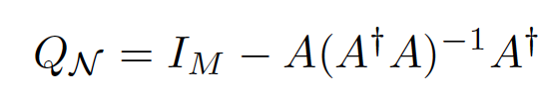
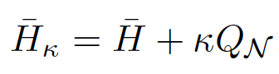
Exclude the bad projectability states from the set of bands to be represented (filtering) – orthogonal projection
Introduces a spurious null space that must be eliminated
Shift by a fixed energy outside of the region of good projectability bands
(shifting)
12

Slide 13
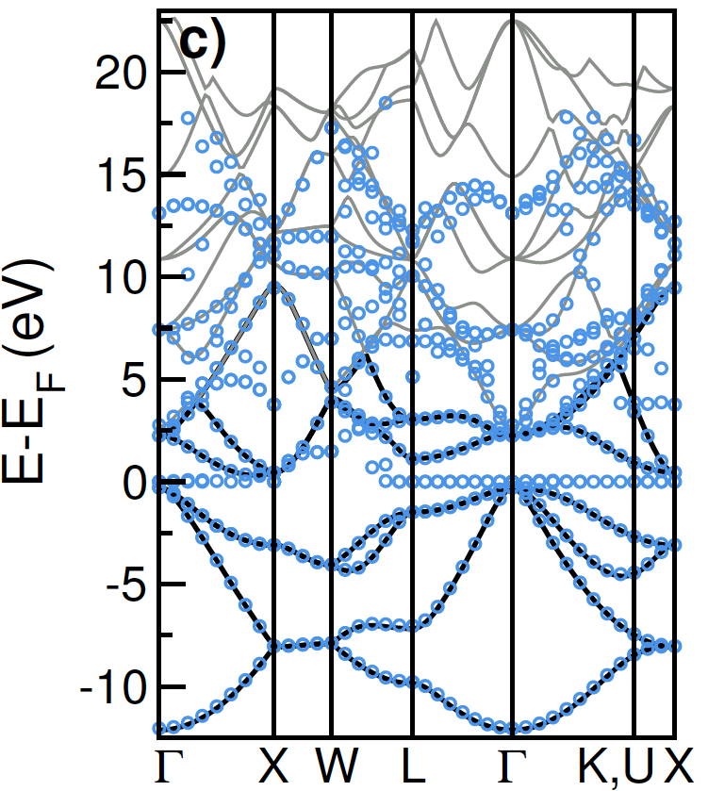
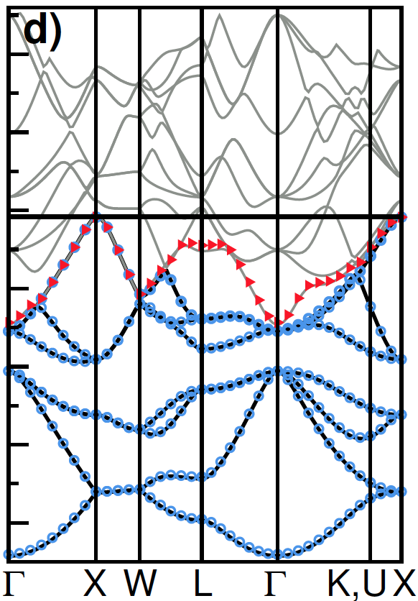
Accurate PAO Hamiltonians
13

Slide 14
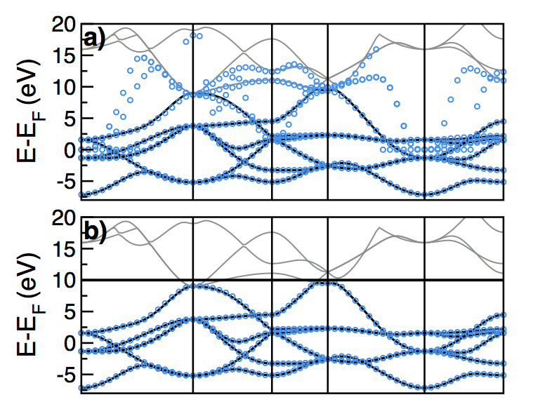
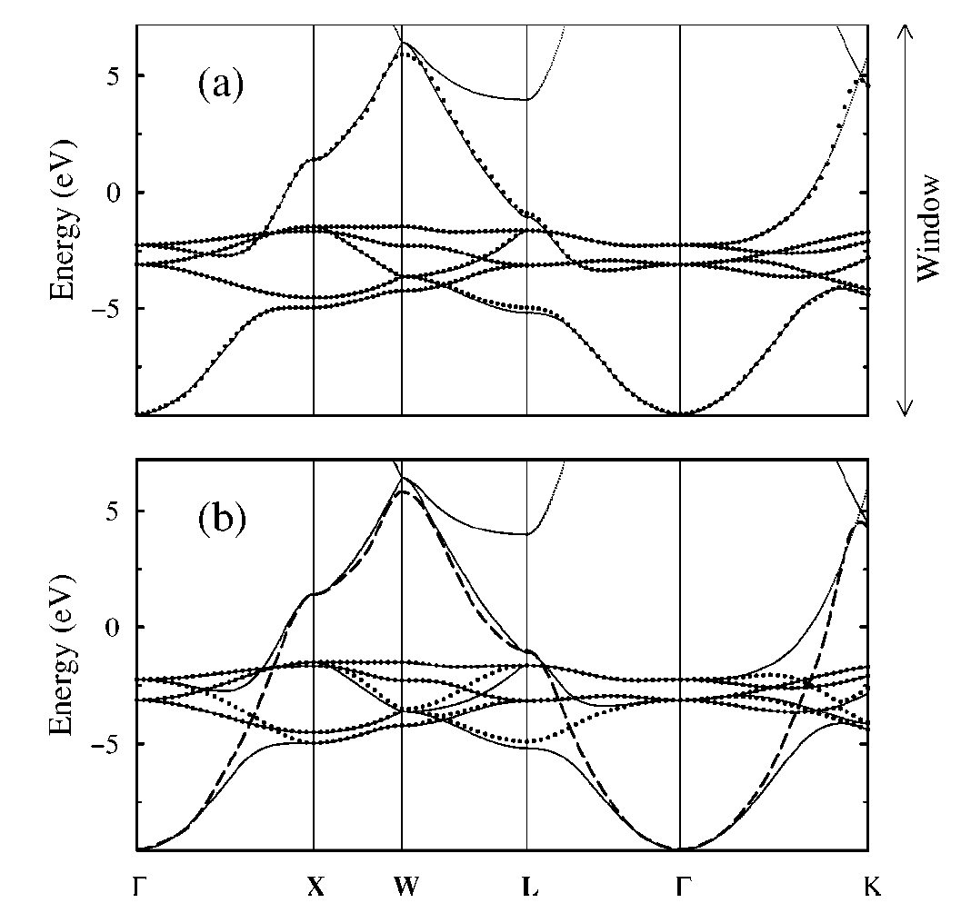
Accurate PAO Hamiltonians
projections
Wannier functions
Mo
Cu
Effective description of entangled bands in metals

Slide 15
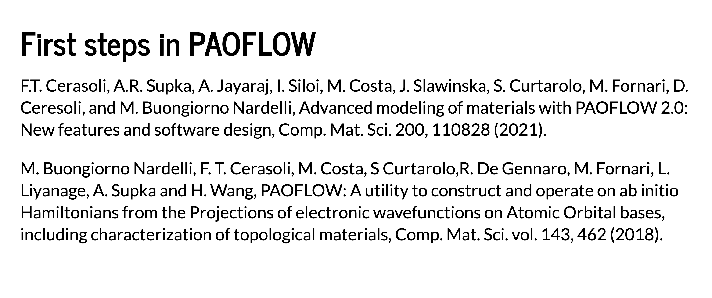
pip install paoflow

Slide 16

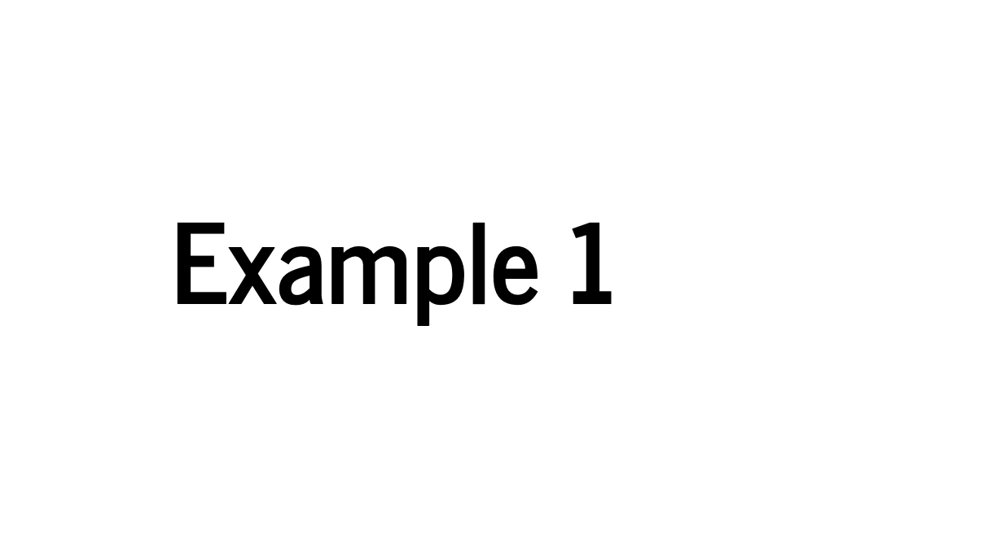


Slide 17
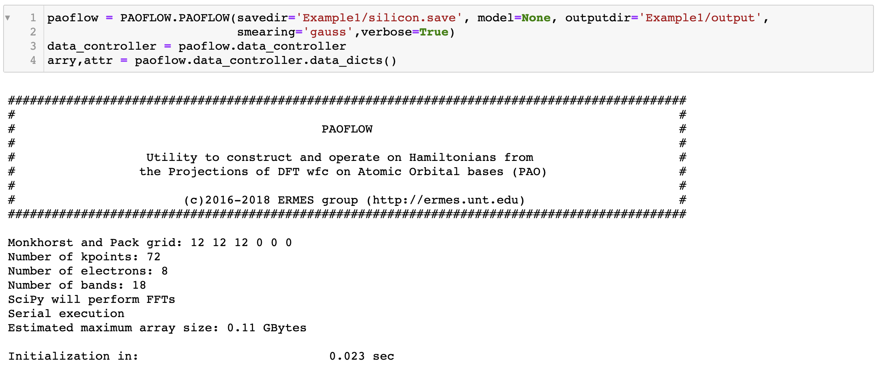

Slide 18
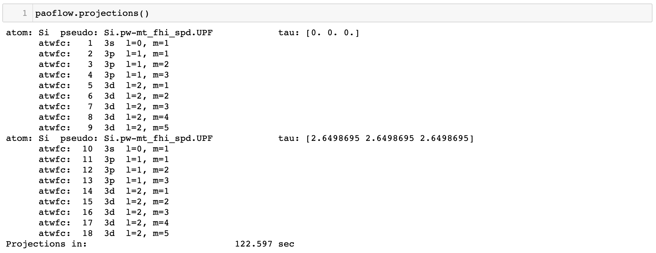

Slide 19
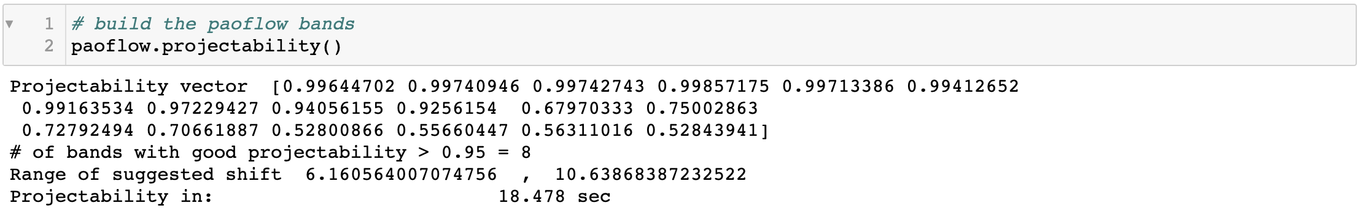
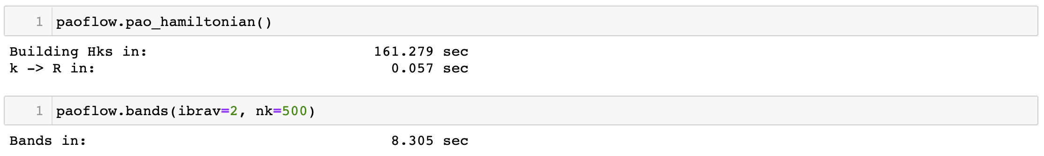

Slide 20
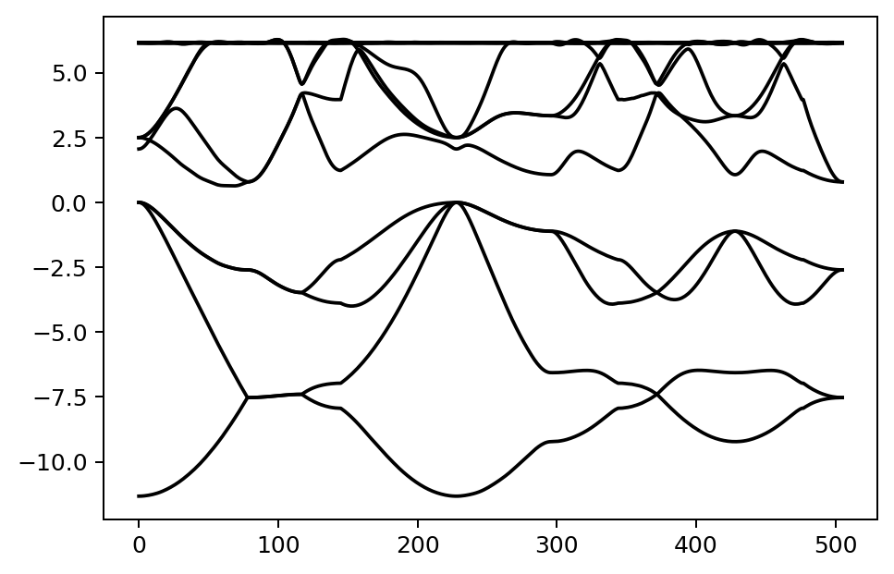

Slide 21
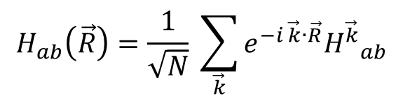
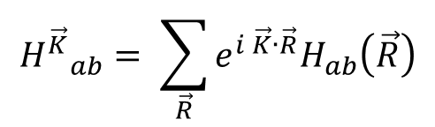
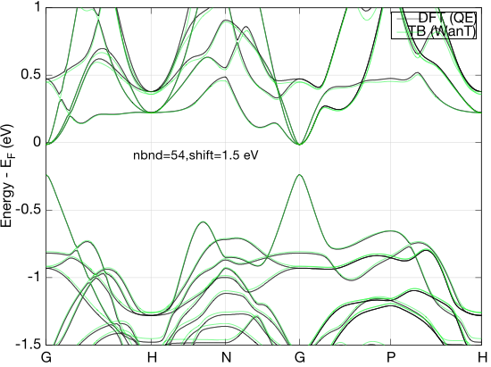
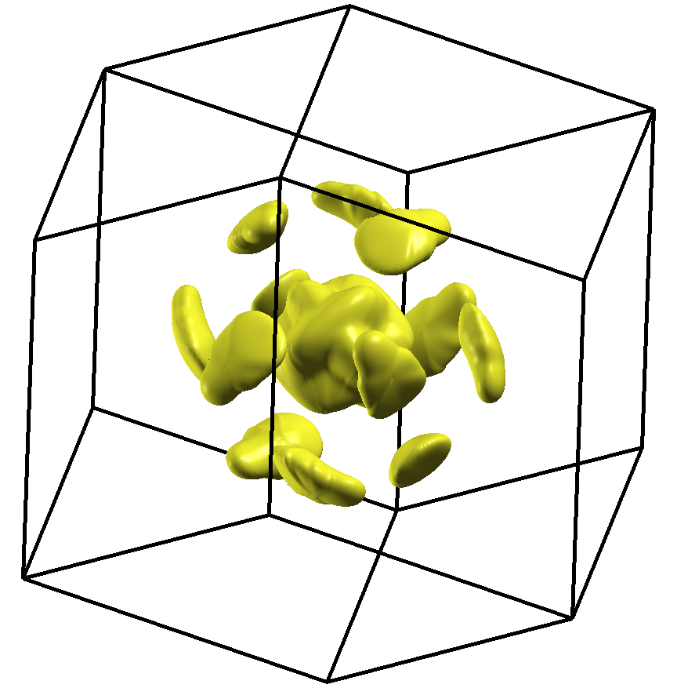

K-point interpolation
Convergence of multi-valley bands as the electronic origin of high thermoelectric performance in CoSb₃ skutterudites, Y. Tang, Z.M. Gibbs, L.A. Agapito, G. Li, H. Kim, M. Buongiorno Nardelli, S. Curtarolo and G.J. Snyder
21

Slide 22
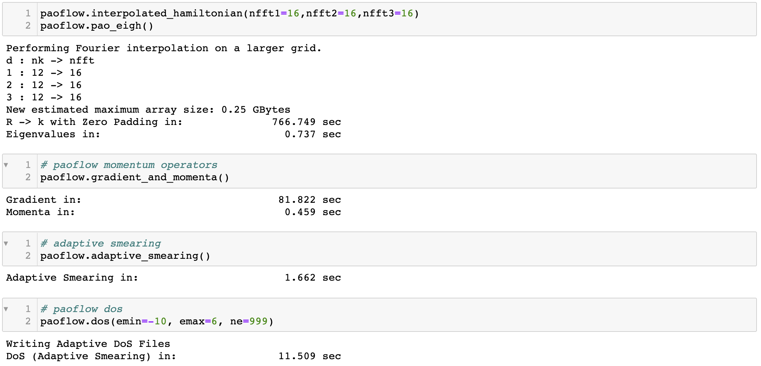

Slide 23
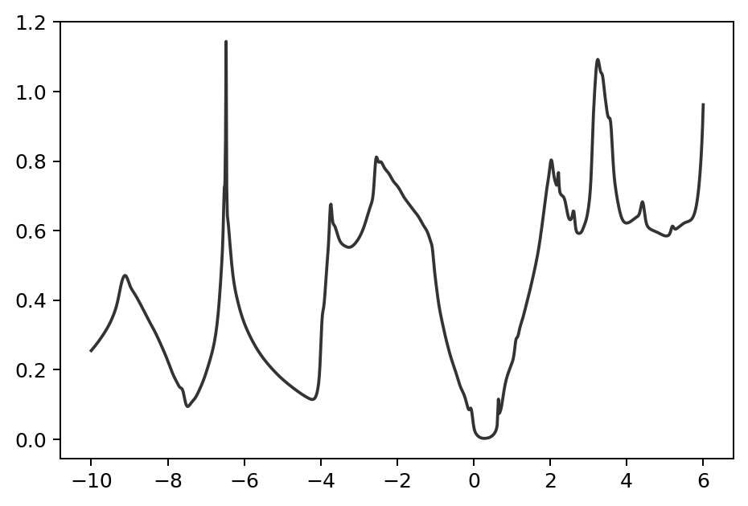

Slide 24
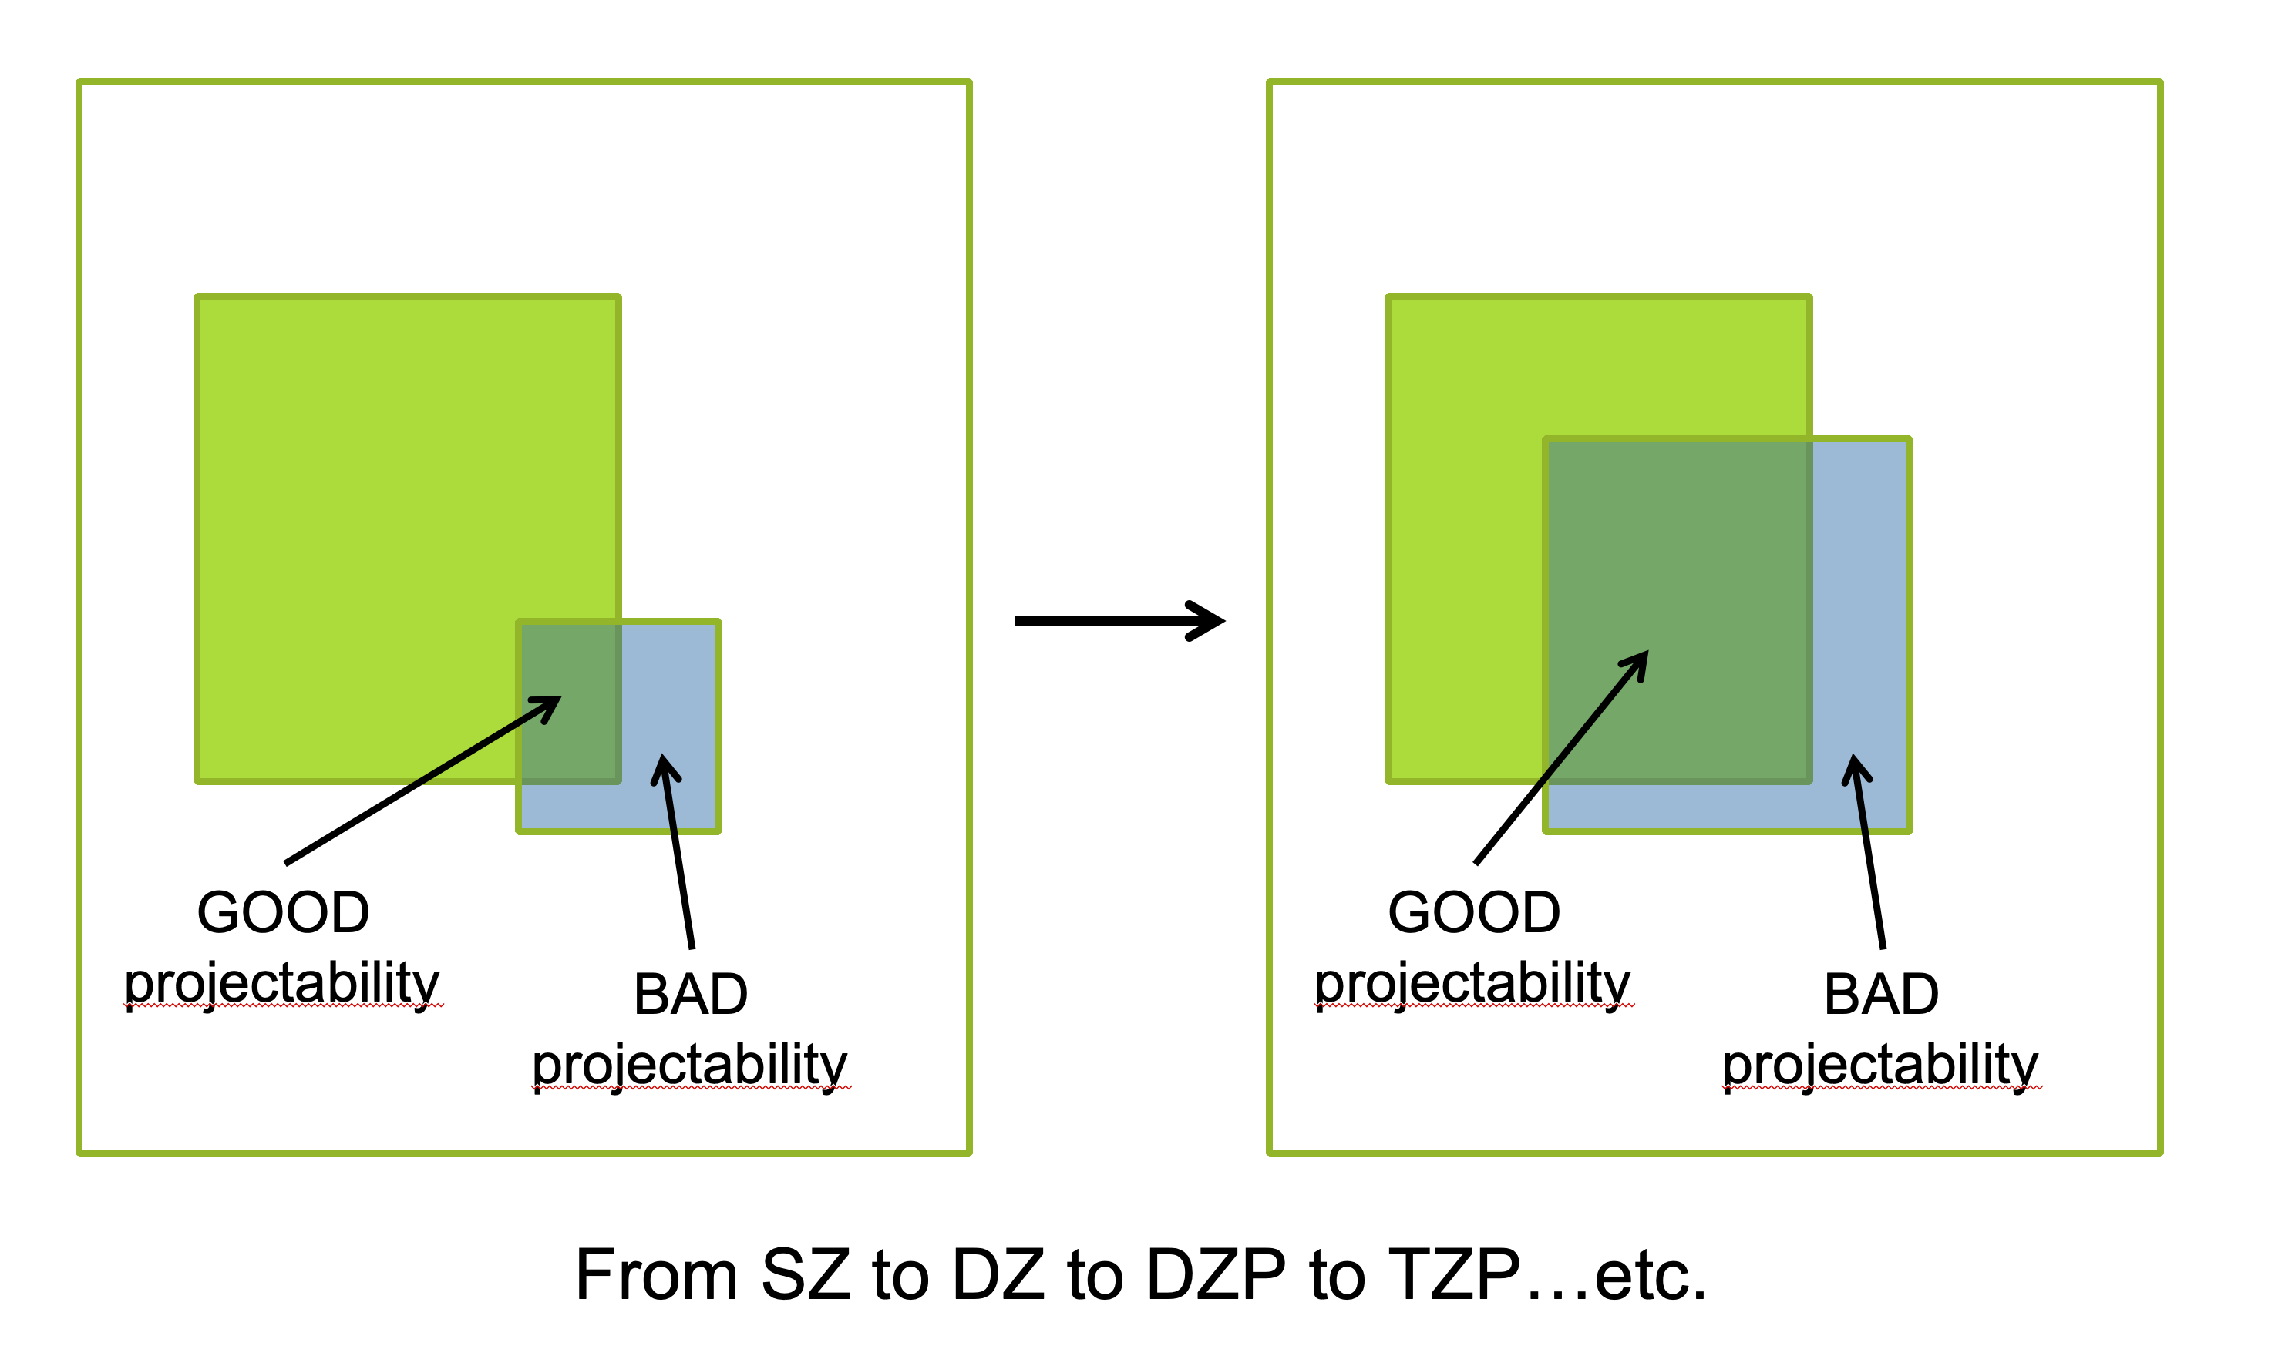
Increase the basis set

Slide 25



Slide 26
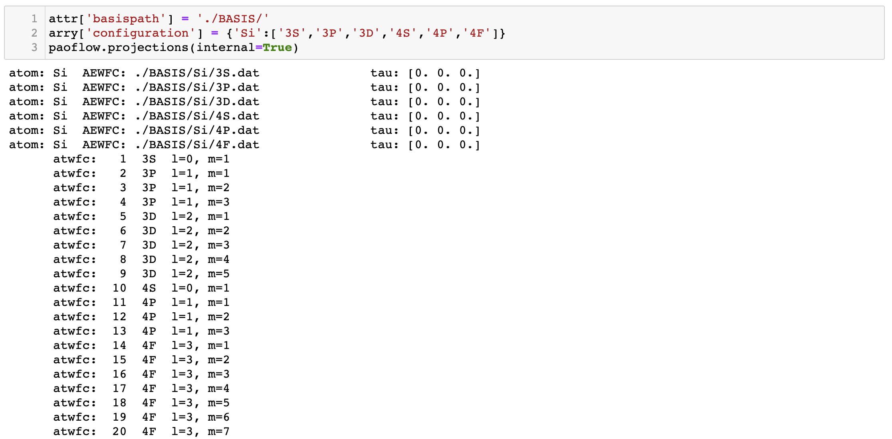

Slide 27
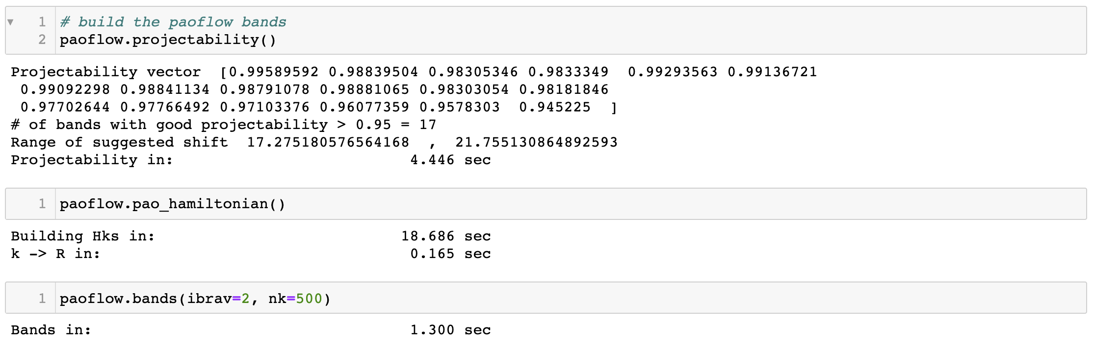

Slide 28
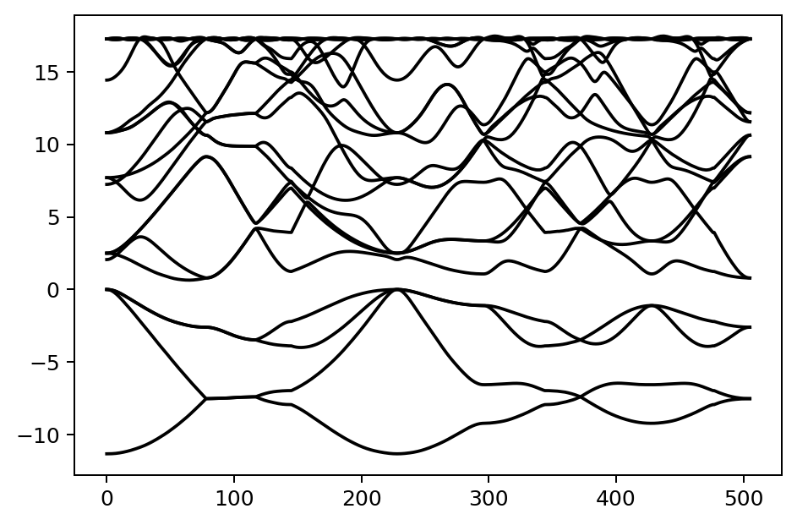

Slide 29
PAOFLOW capabilities
Construction of PAO Hamiltonians from the DFT wavefunctions onto pseudo atomic orbitals
Construction of PAO Hamiltonians from analytical tight binding models
Hamiltonian data for further processing (ACBN0, PAOtransport, etc.)
External fields and non scf ACBN0 correction
Spin orbit correction of non SO calculations
Bands along standard paths in the BZ
Real space electronic charge density
Interpolation of Hamiltonians on arbitrary Monkhorst and Pack k-meshes
Adaptive smearing for BZ and Fermi surface integration
Density of states (and projected DOS)
Fermi surfaces and spin textures
Boltzmann transport (conductivity, Seebeck coefficient, electronic contribution to thermal conductivity
dielectric function (absorption coefficients and EELS)
Berry curvature and anomalous Hall conductivity (including magnetic circular dichroism spectra)
spin Berry curvature and spin Hall conductivity (including spin circular dichroism spectra)
Band topology (Z2 invariants, Berry and spin Berry curvature along standard paths in BZ, critical points

Slide 30
Some more advanced applications

Slide 31
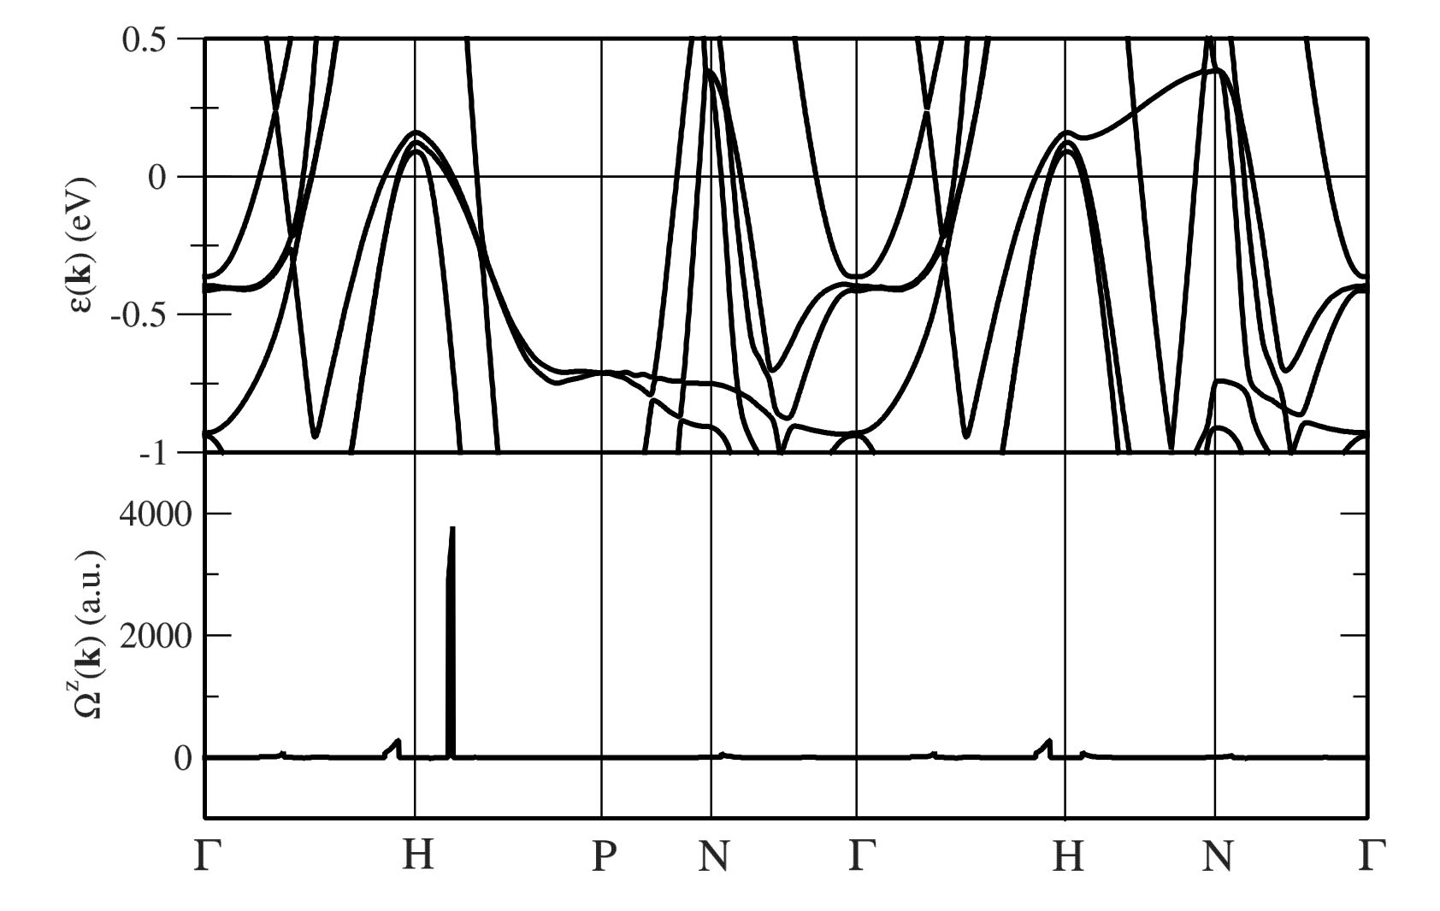
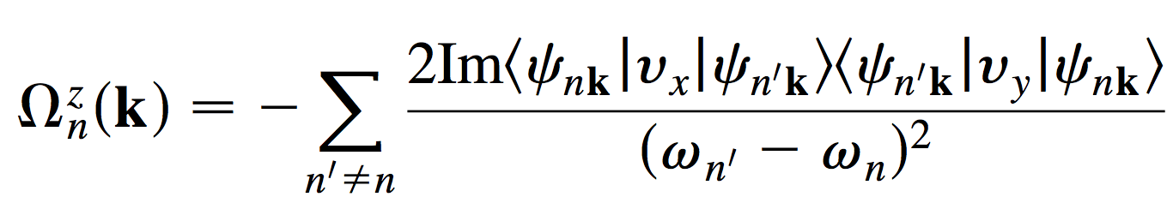
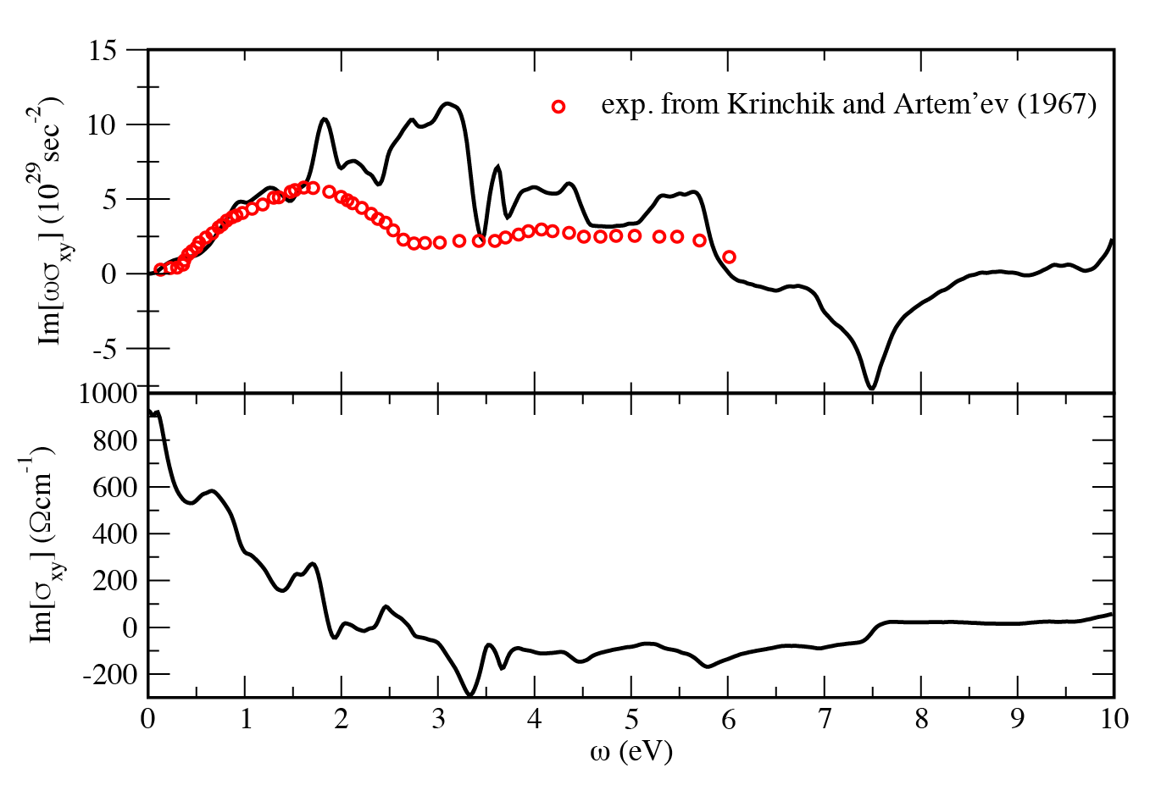
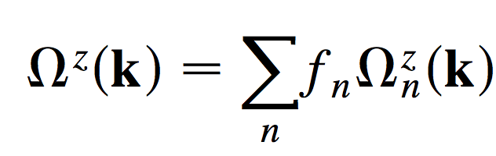
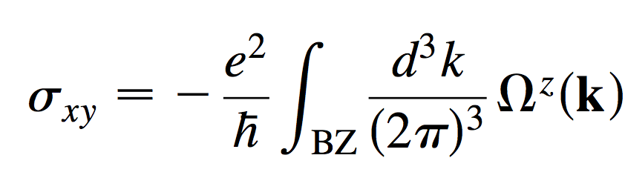
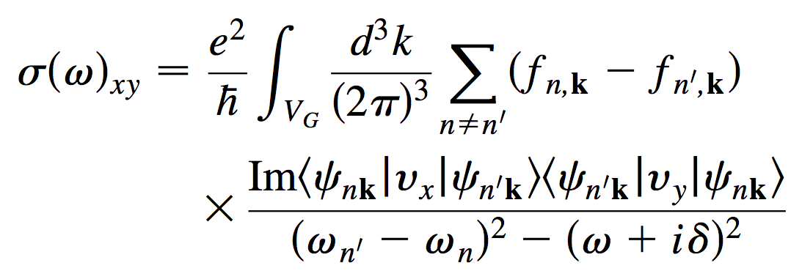
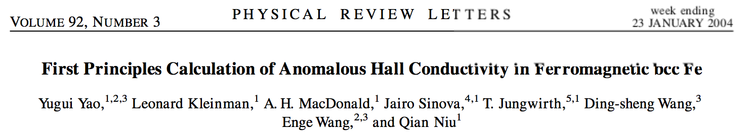
Berry curvature and Anomalous Hall conductivity: Fe
Berry curvature from Kubo formula:
Anomalous Hall conductivity:

Slide 32



Spin Hall conductivity

Slide 33



Slide 34


Slide 35


Slide 36



Slide 37



Slide 38



Topological invariants
MoTe₂: A Type-II Weyl Topological Metal
z2pack.ethz.ch/doc/2.1/index.html
Wang et al., 10.1103/PhysRevLett.117.056805

Slide 39

Nodal chain and Weyl points in HfC

